Slide 1
Final Project
Pokemon dataset
Michal Hél, Michaela Čechová

Slide 2
Goal of the project:
To automatically recognize and classify first-generation Pokémon based on their images using machine learning techniques, specifically neural networks.
🔍 Expanded Explanation
The model is designed to:
Analyze image data of Pokémon
Learn visual patterns and features that distinguish each Pokémon
Predict the correct Pokémon name or category when shown a new image
Improve accuracy and efficiency in image classification tasks using advanced architectures like DenseNet121 and ResNet101

Slide 3

Dataset - First Gen Pokémon Classification
Dataset Overview
Contains 151 first-generation Pokémon
3,089 images
Images are pre-sorted into training and testing folders
Designed for image classification
Tested Models:
Transfer Learning
Custom Neural Network – Grayscale

Slide 4
Custom neural network - Data preparation
Defined training and testing datasets Set image size
Encoding: label_mode="categorical" – assigns labels based on folder names
Batch size set to 32
For custom neural network: color_mode="grayscale"

Slide 5
Custom Neural Network - parametres for training
Used grayscale input
Image size: 128×128 pixels (other sizes tested, no significant impact)
Augmentation tested – no improvement
Architecture tuning:
Dropout: 0.4
Batch Normalization
EarlyStopping and ReduceLROnPlateau
Activation functions: ReLU, Softmax
Loss function: CategoricalCrossentropy with Label Smoothing – best results
100 epochs

Slide 6
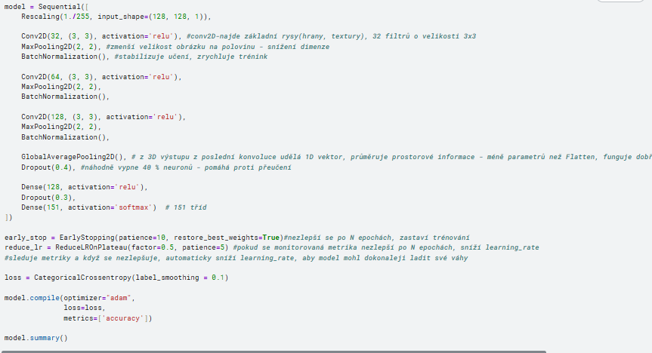

Slide 7
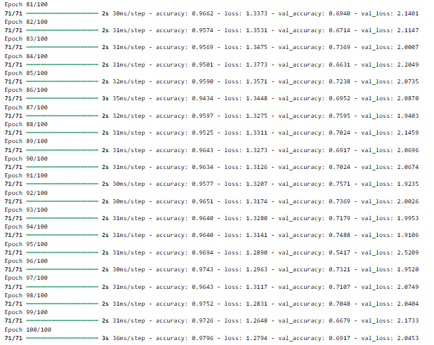

Slide 8
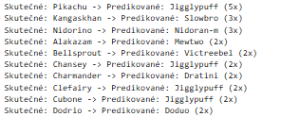
Top 10 Most Common Misclassifications (Real->predicted)

Slide 9
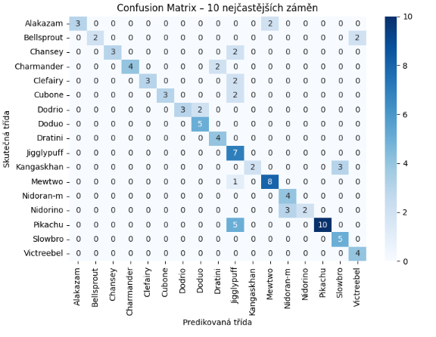

Slide 10
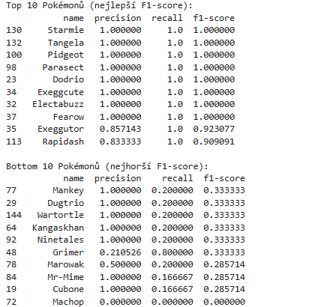
Classification report (TOP10 Best and worst F1 score)

Slide 11
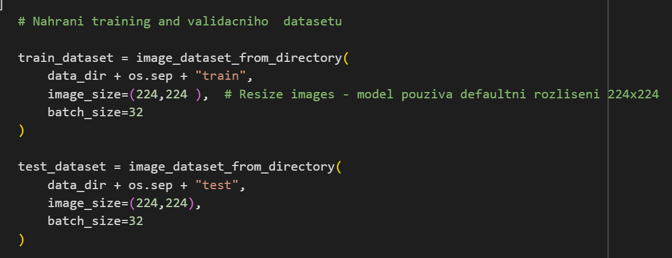
Transfer Learning
Transfer Learning Models:
DenseNet121
ResNet101 (for performance comparison)
Data Preparation:
Both models use 224×224 RGB images
References:
https://keras.io/api/applications/densenet/
https://keras.io/api/applications/resnet/

Slide 12
Model Performance:
DenseNet121: accuracy 96,67% for TEST dataset and 98,37% for TRAIN dataset. Loss: 0.1607
ResNet101: accuracy 90,36% for TEST dataset and 100% for TRAIN dataset. Loss: 0.5108

Slide 13
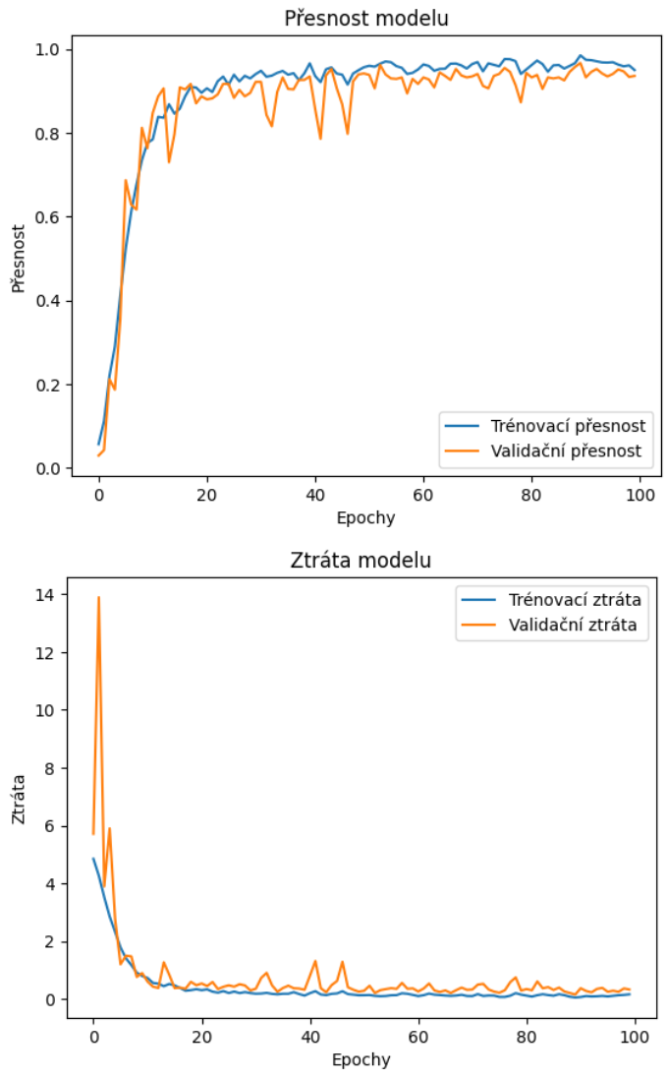
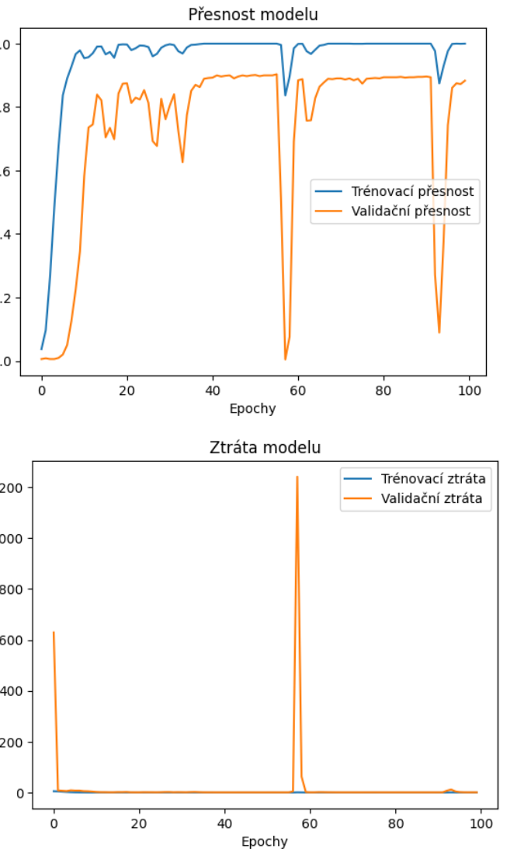
Graphs for Accuracy and Loss
DenseNet121
ResNet101

Slide 14
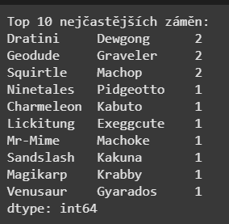
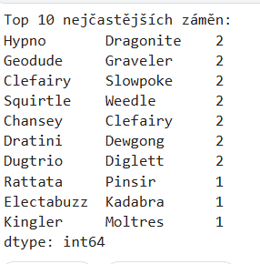
Classic matrix was too cluttered for 151 classes so it was replaced by table for TOP 10 misclassification
DenseNet121
ResNet101

Slide 15
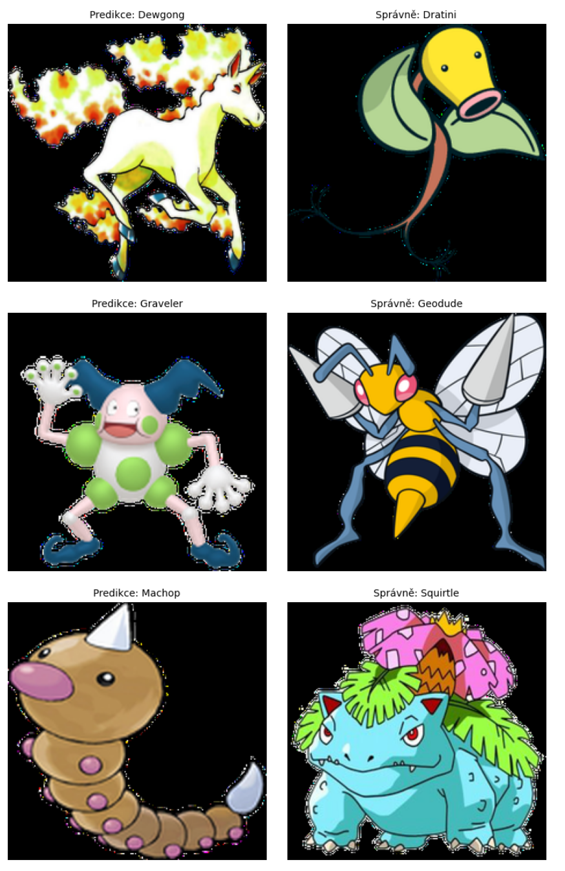
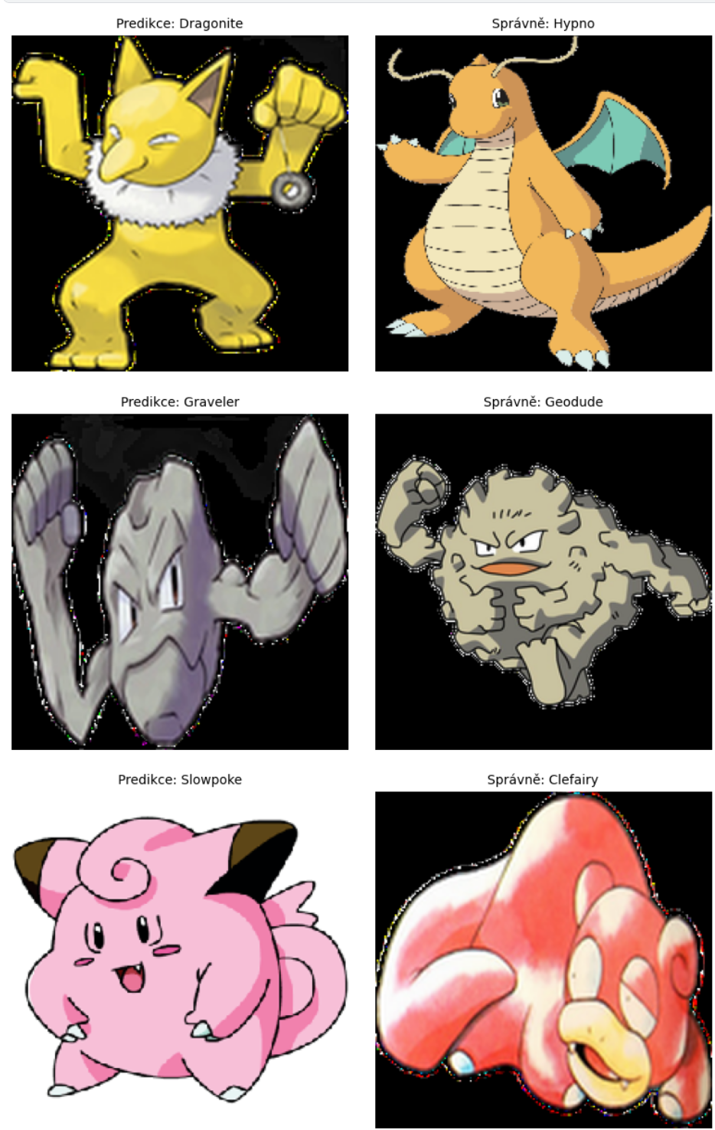
Visual comparison of TOP 3 most frequent misclassification
DenseNet121
ResNet101

Slide 16
Models Evaluation
- Custom Neural Network:
fastest training
~70% accuracy
- ResNet101:
~7 million parameters
~90% accuracy
slowest training (~2× slower than DenseNet12
~40 million parameters
- DenseNet121:
~7 million parameters
Faster than ResNet101, but still ~10× slower than custom model
Best accuracy: ~97%
Freeze Comparison
DenseNet121 with Frozen Layers:
Accuracy: 92.74%
Training time: ~⅓ of original model
Useful for large datasets to save resources

Slide 17
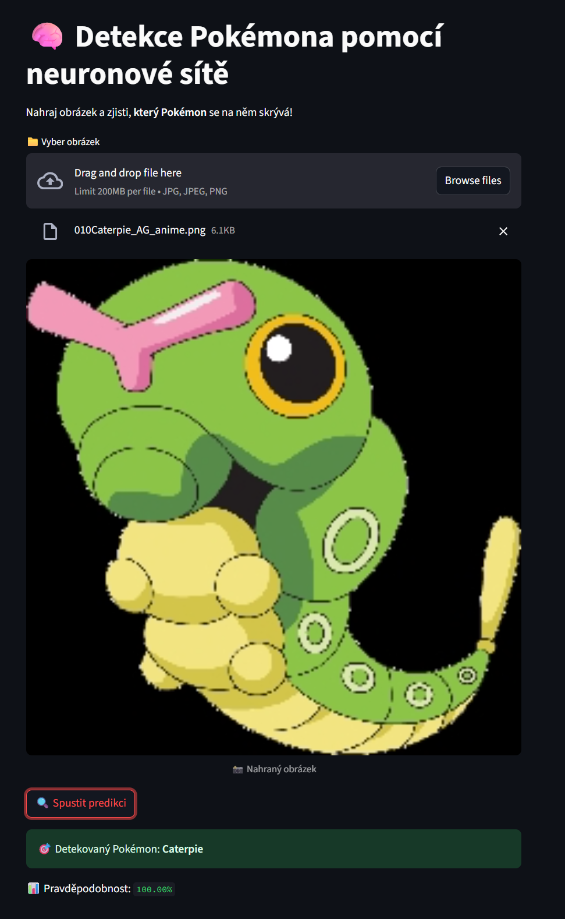
Bonus: Interactive Web Application
Built with StreamLit python library
Allows easy image upload and prediction display
Works locally in PyCharm or via web browser
Deployed in Google Cloud container
App link:
https://streamlit-app-870839547599.europe-central2.run.app/

